Slide 1
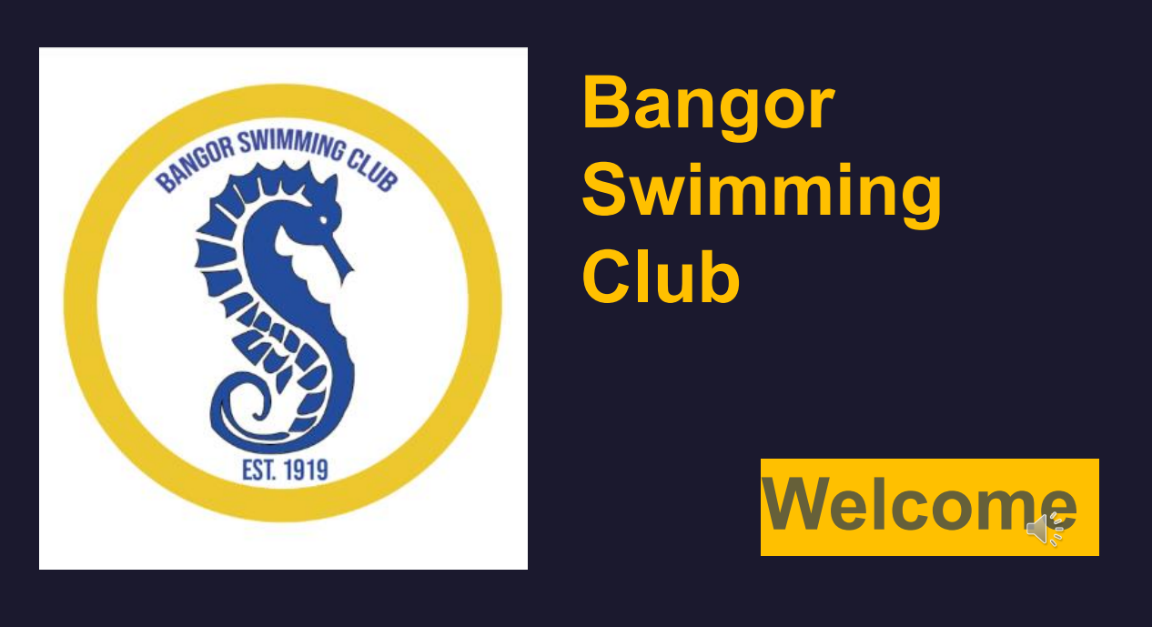


Slide 2
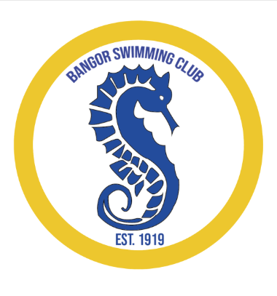
Mission and Philosophy of BSC
Bangor swimmers will be:
• Central to all club activities
• Coached and mentored to achieve their athletic potential
• Instructed on how to develop personal and life skills
• Nurtured in an environment that demonstrates the value of hard work and honest effort in achieving success
• Educated, through experience, about the importance of team support and the benefits of receiving support from teammates
• Taught the significance of respect, learning to win with humility and lose with determination
• Encouraged to commit to always giving their personal best
• Guided to understand the philosophy and mindset that embodies the virtues and character of exceptional athletes
• Consistently challenged to strive for improvement.

Slide 3
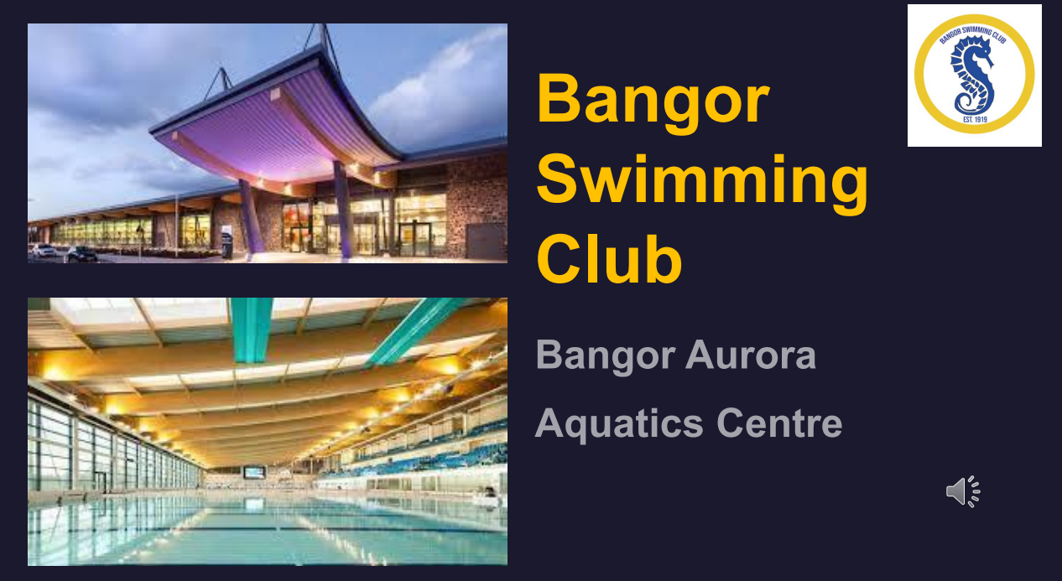

Slide 4
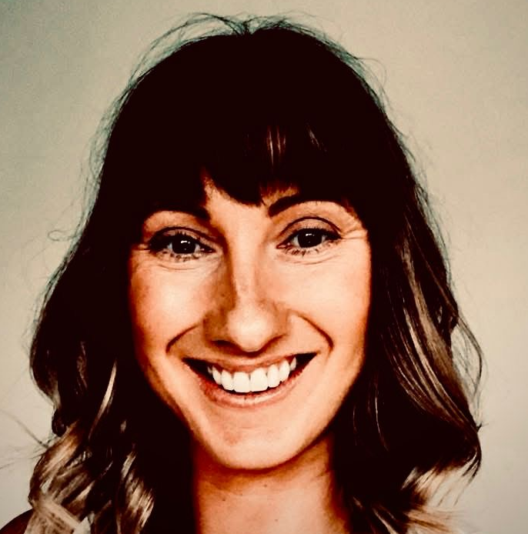
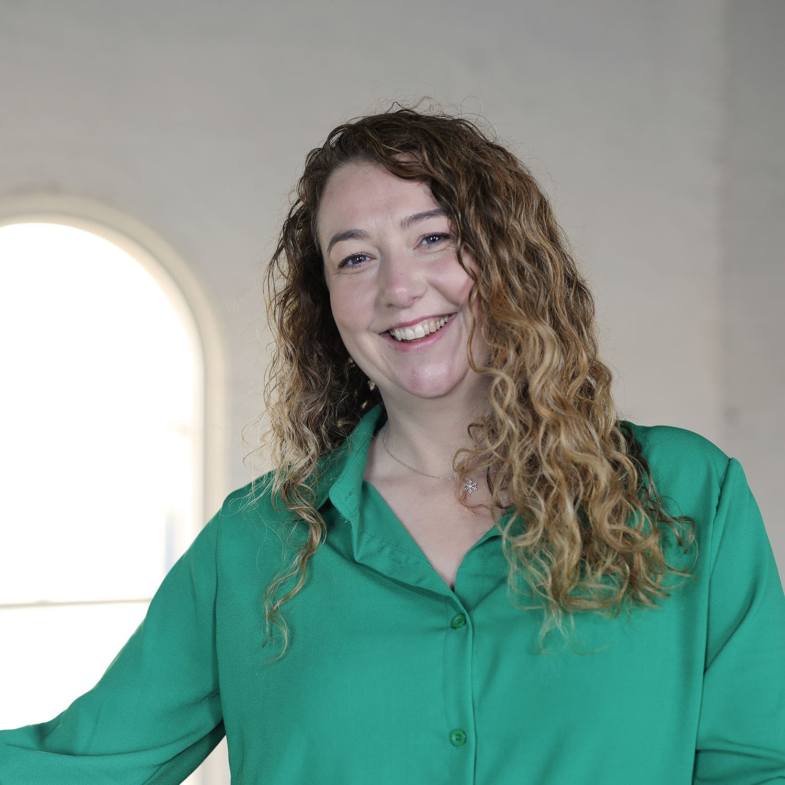
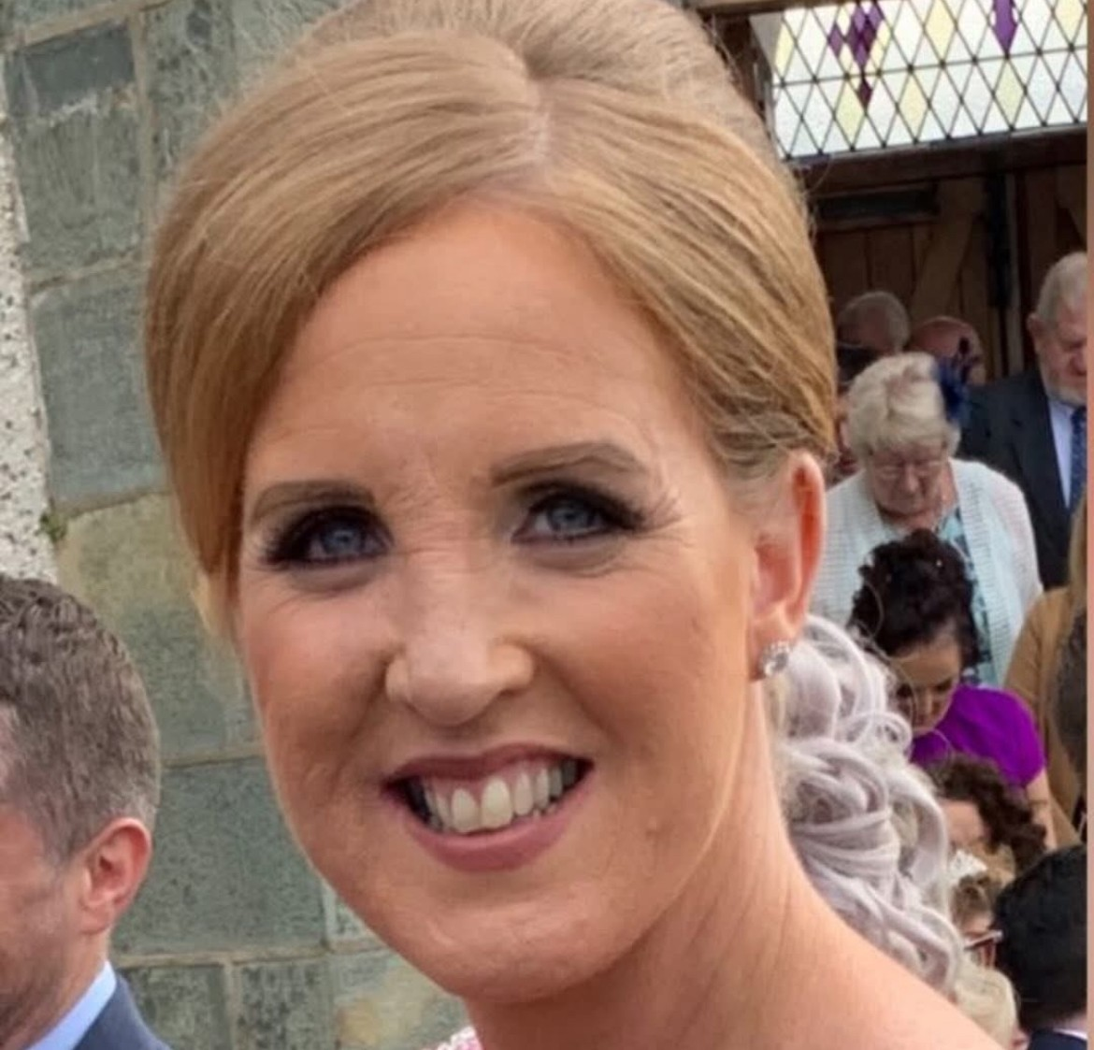
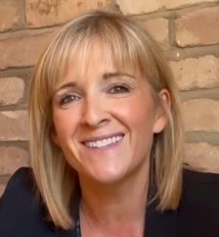
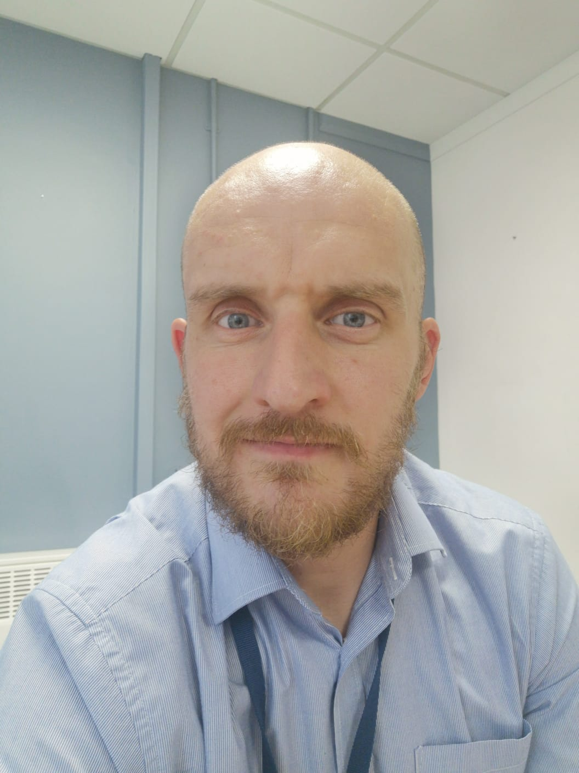
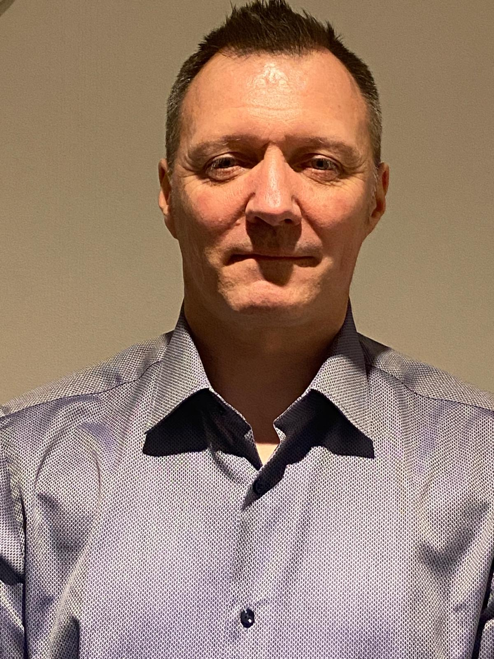
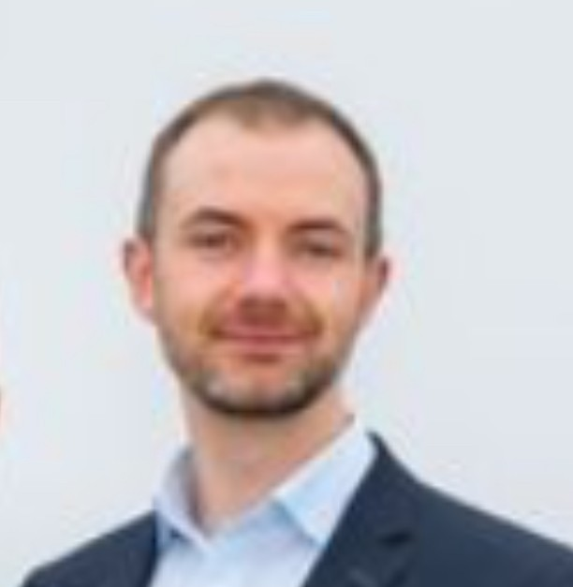
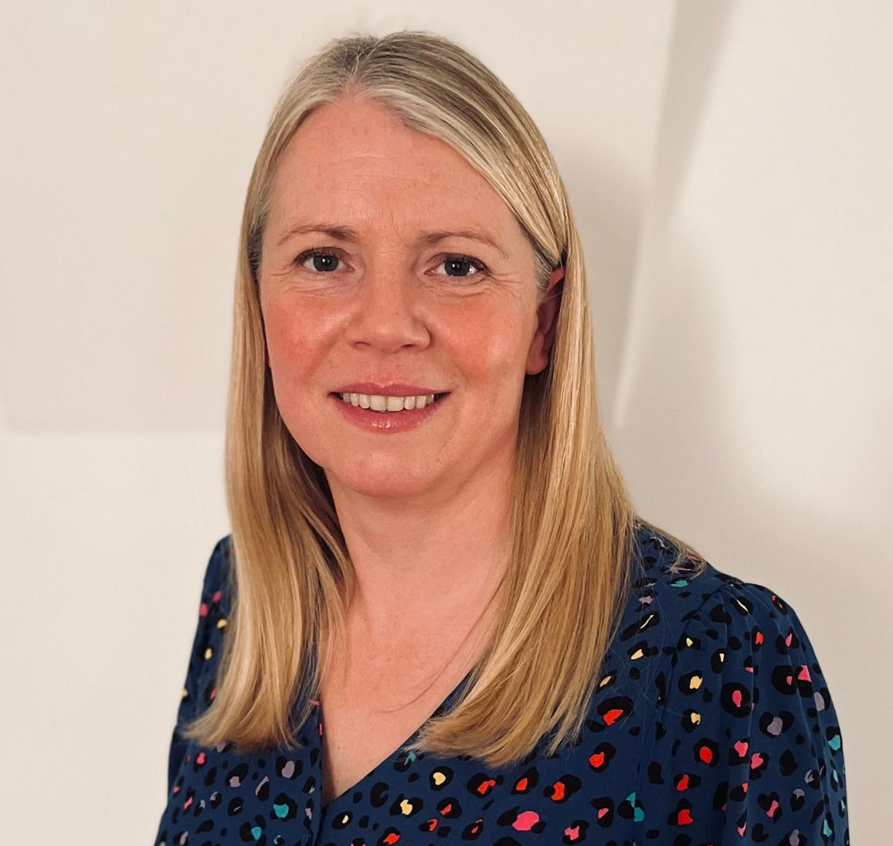
BSC Committee
Rachel Hardy
Chairperson
chair@bangorsc.co.uk
Caroline Kirwan
Secretary
secretary@bangorsc.co.uk
Carol Boal
Treasurer
treasurer@bangorsc.co.uk
Rachel Smyth
Gala Secretary
Stephen Moore
Education Officer
Richard Hamilton
IT support & website
Steven Lavery
Children’s Officer
Catherine Markwell
Membership Secretary

Slide 5
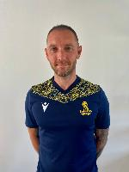
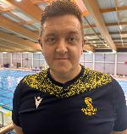
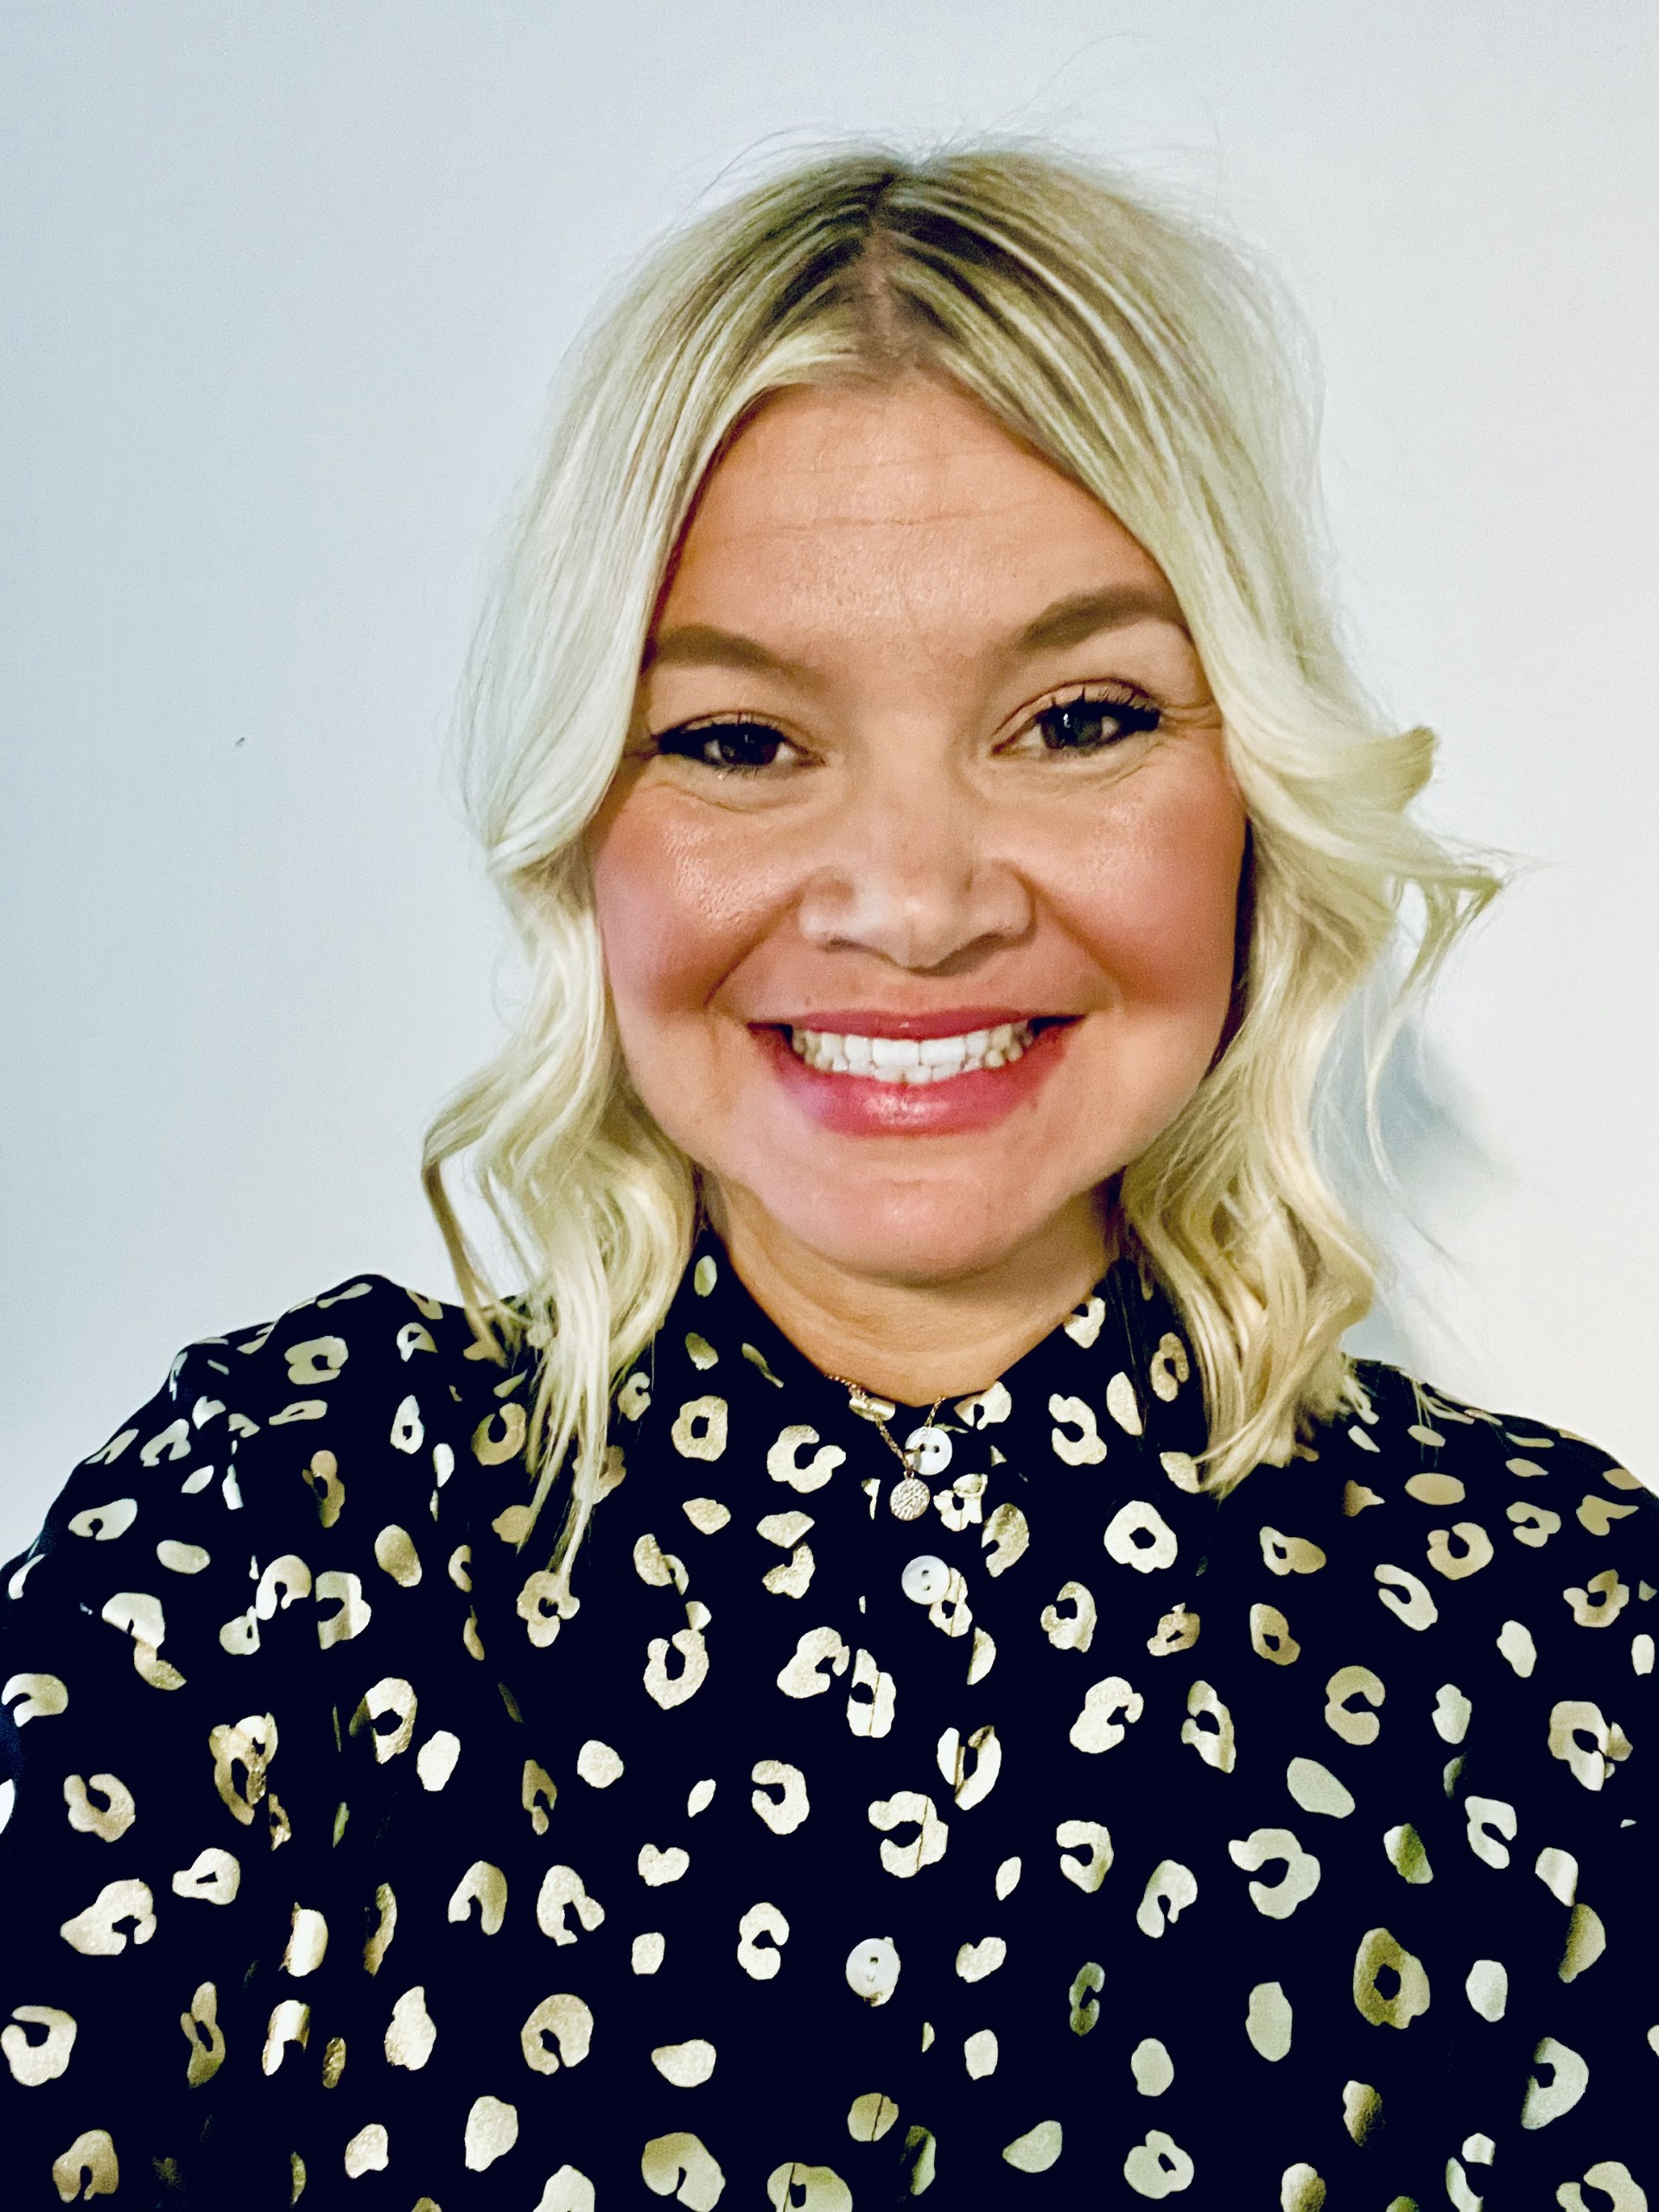
James Hand - Head Coach
Sarah Reynolds
Junior Development Lead
Richard Morrow
AG Lead Coach
BSC Coaching Team

Slide 6
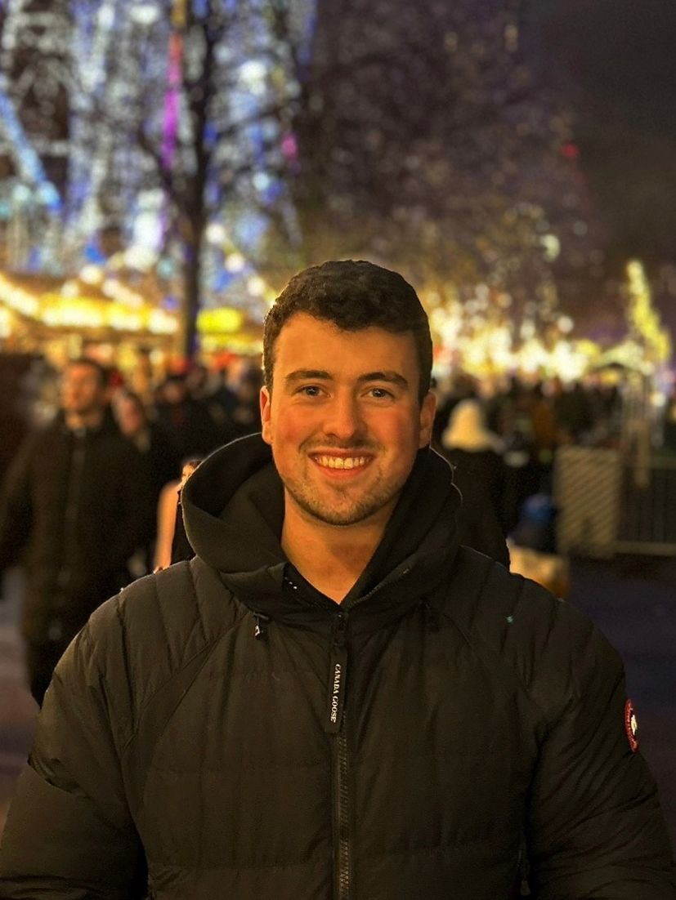
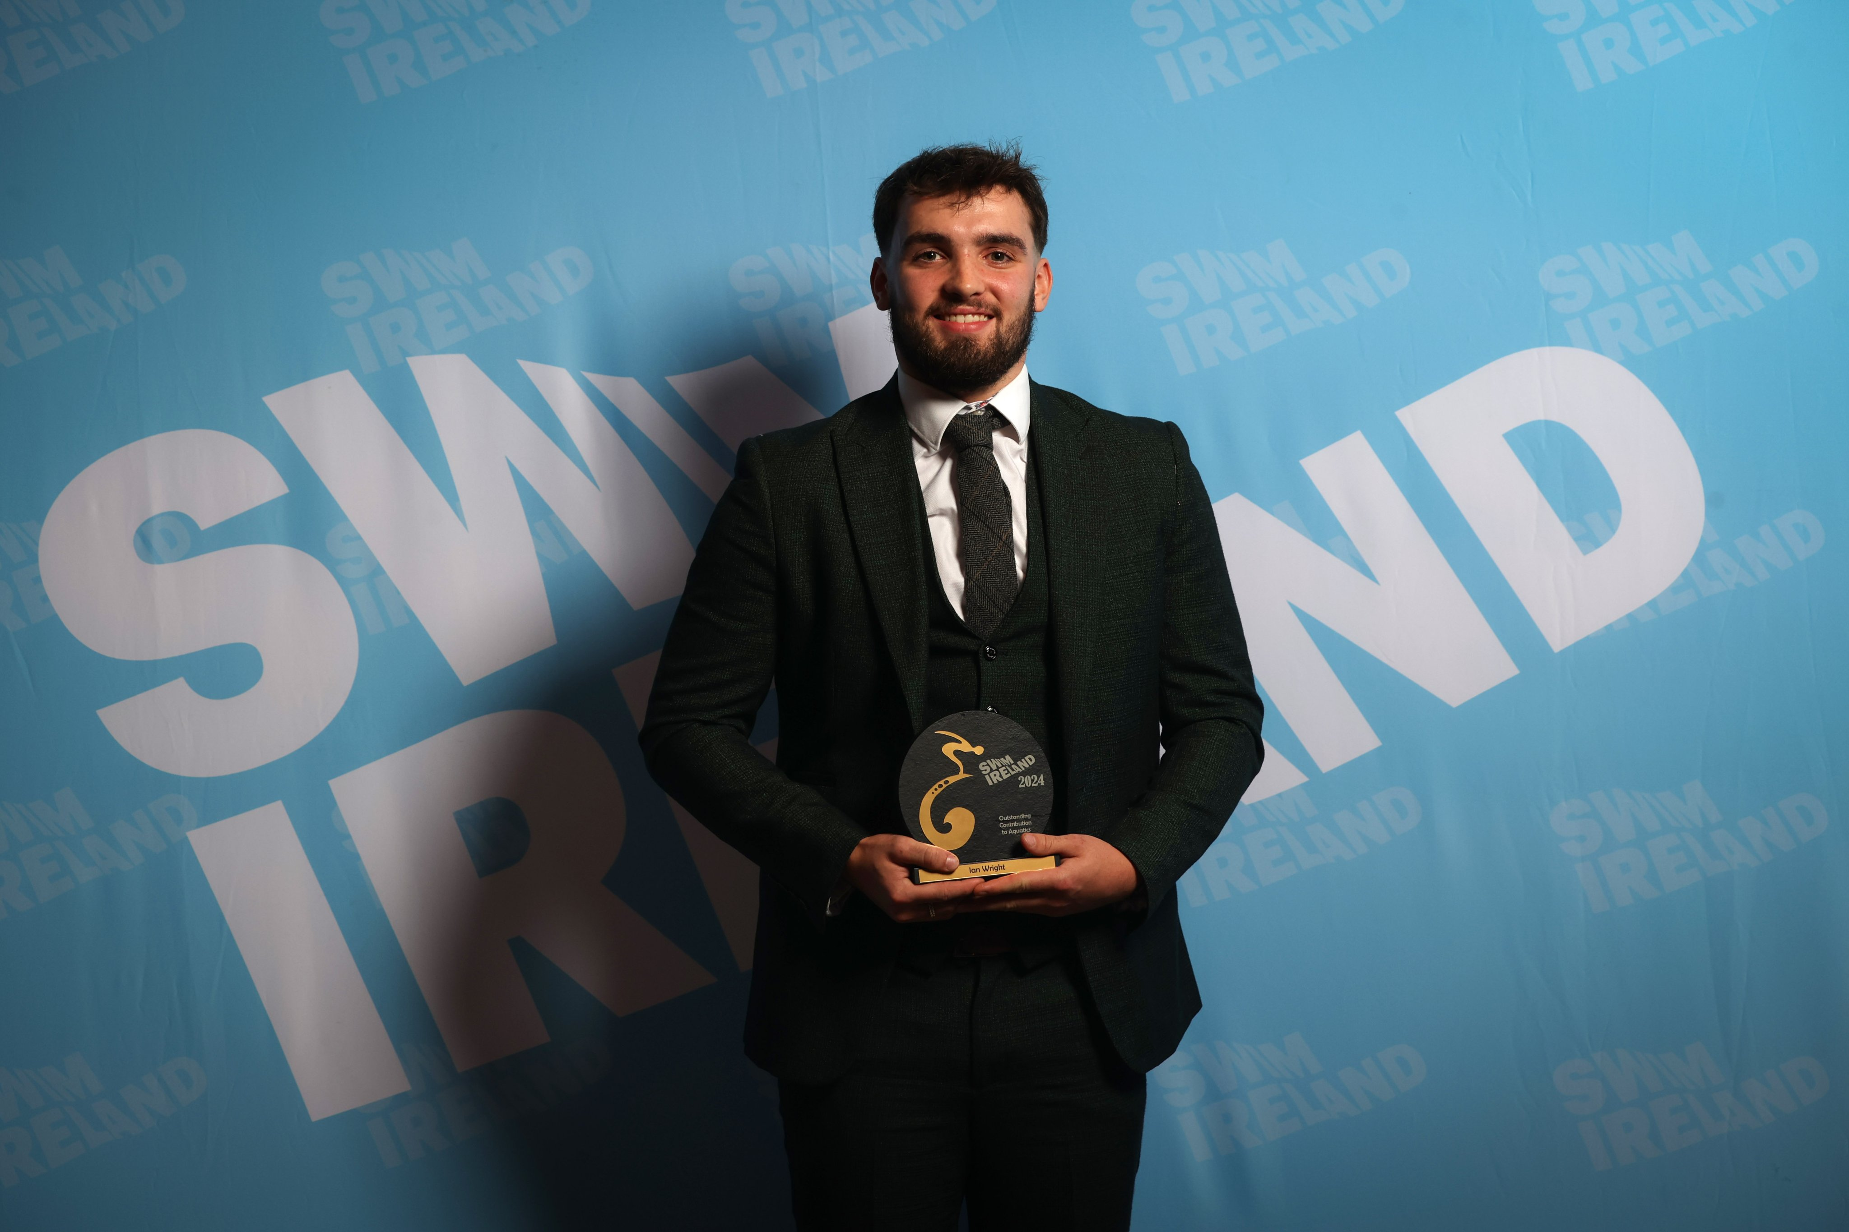
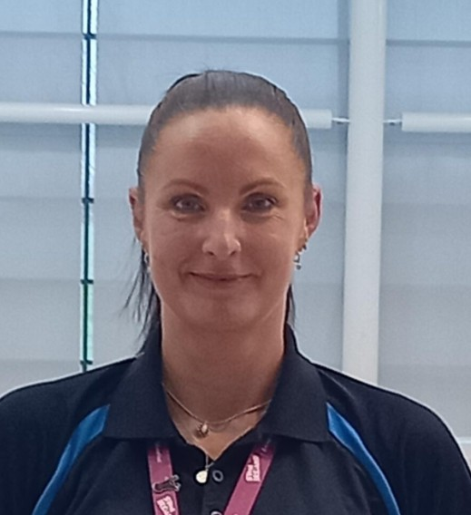
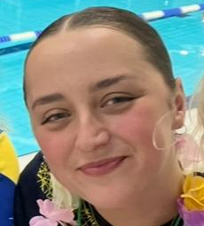
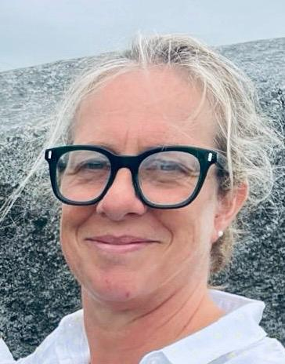
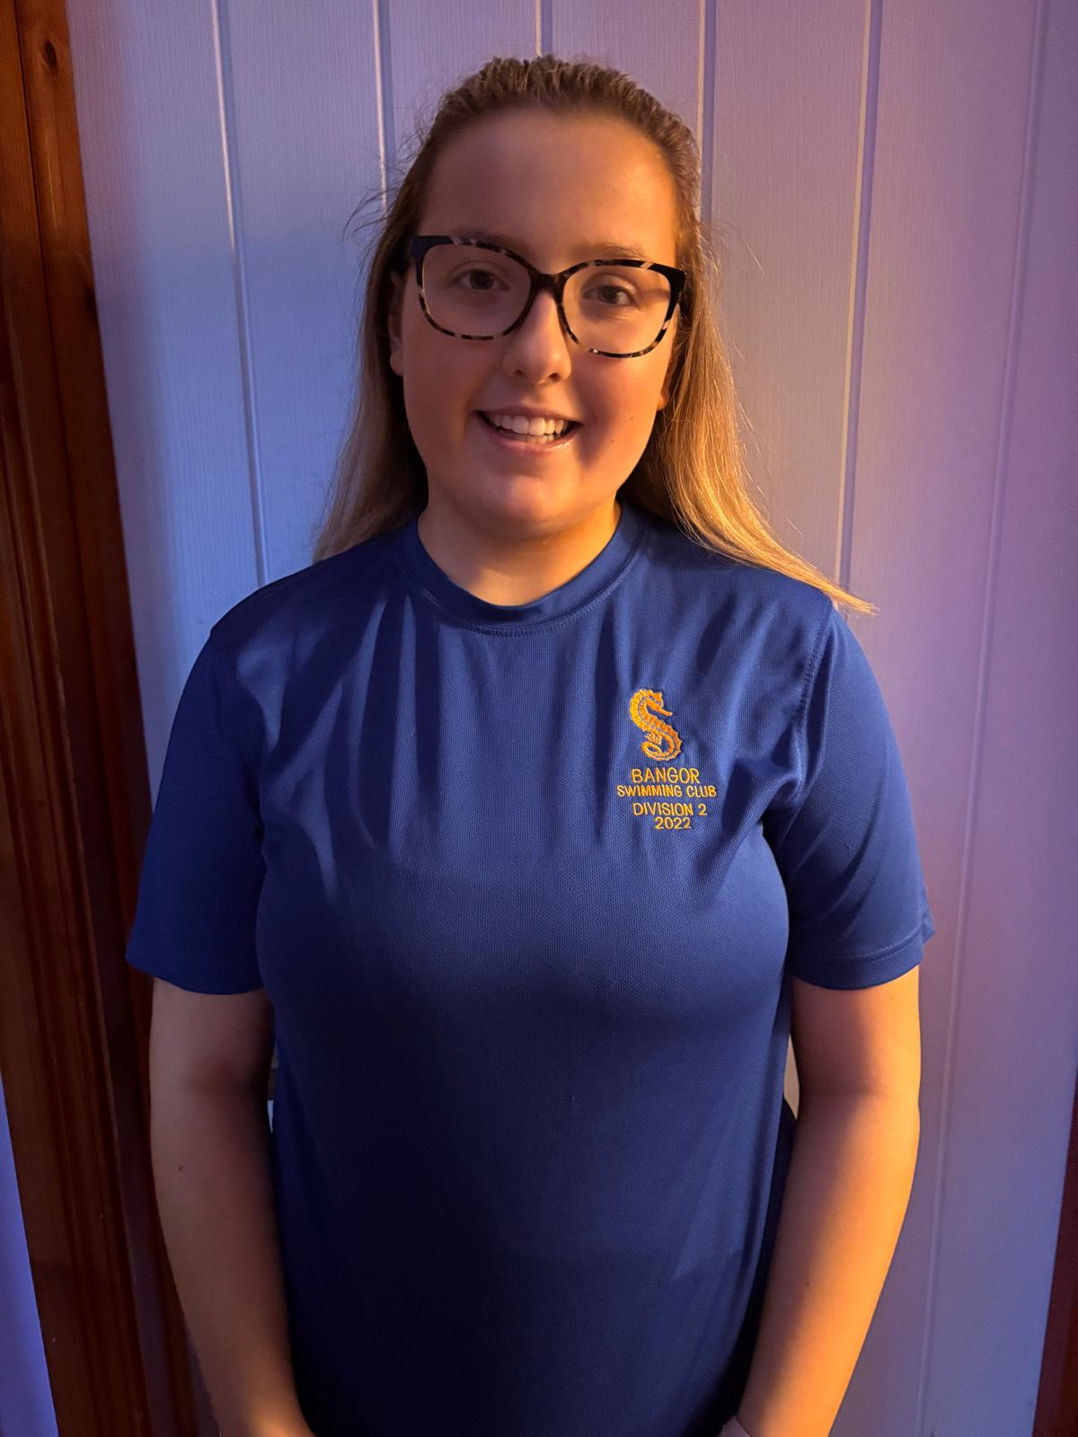
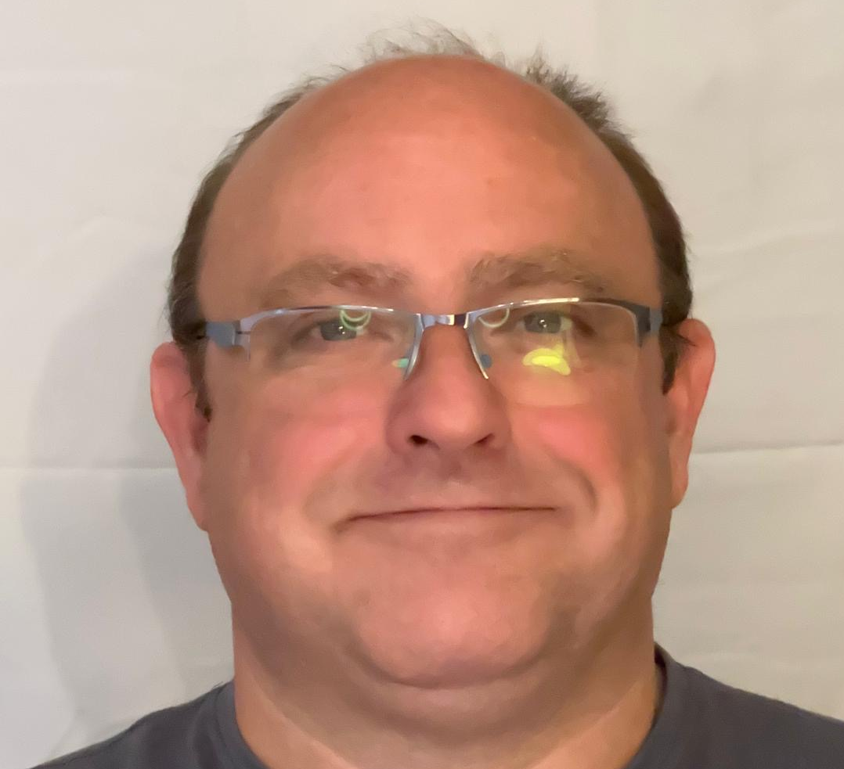
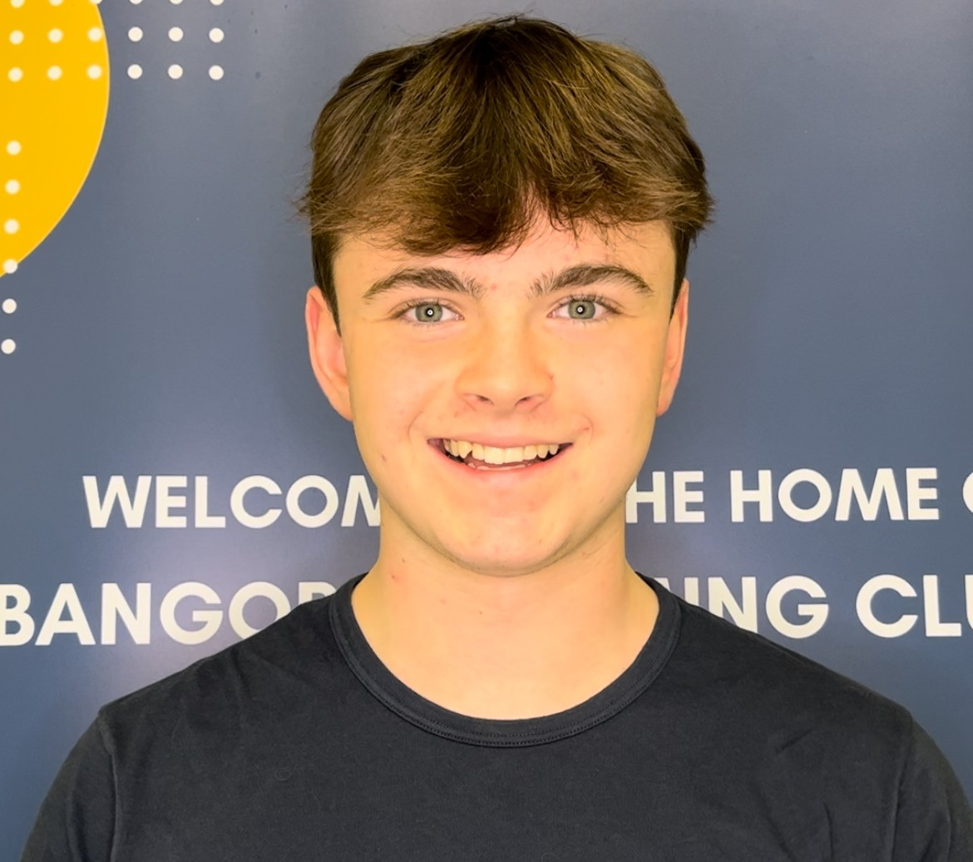
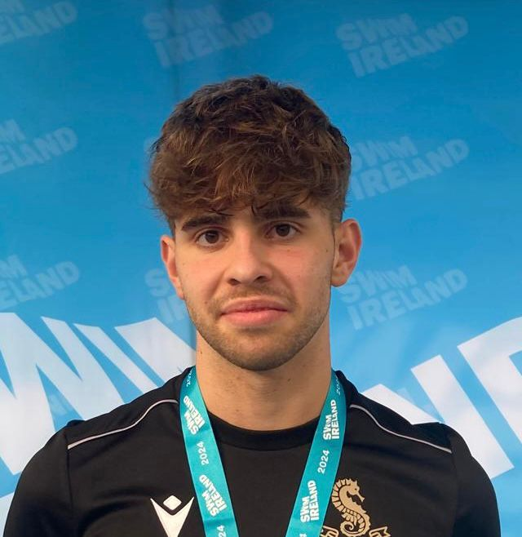
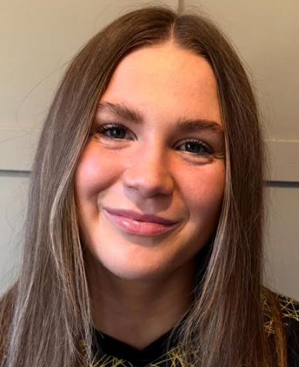
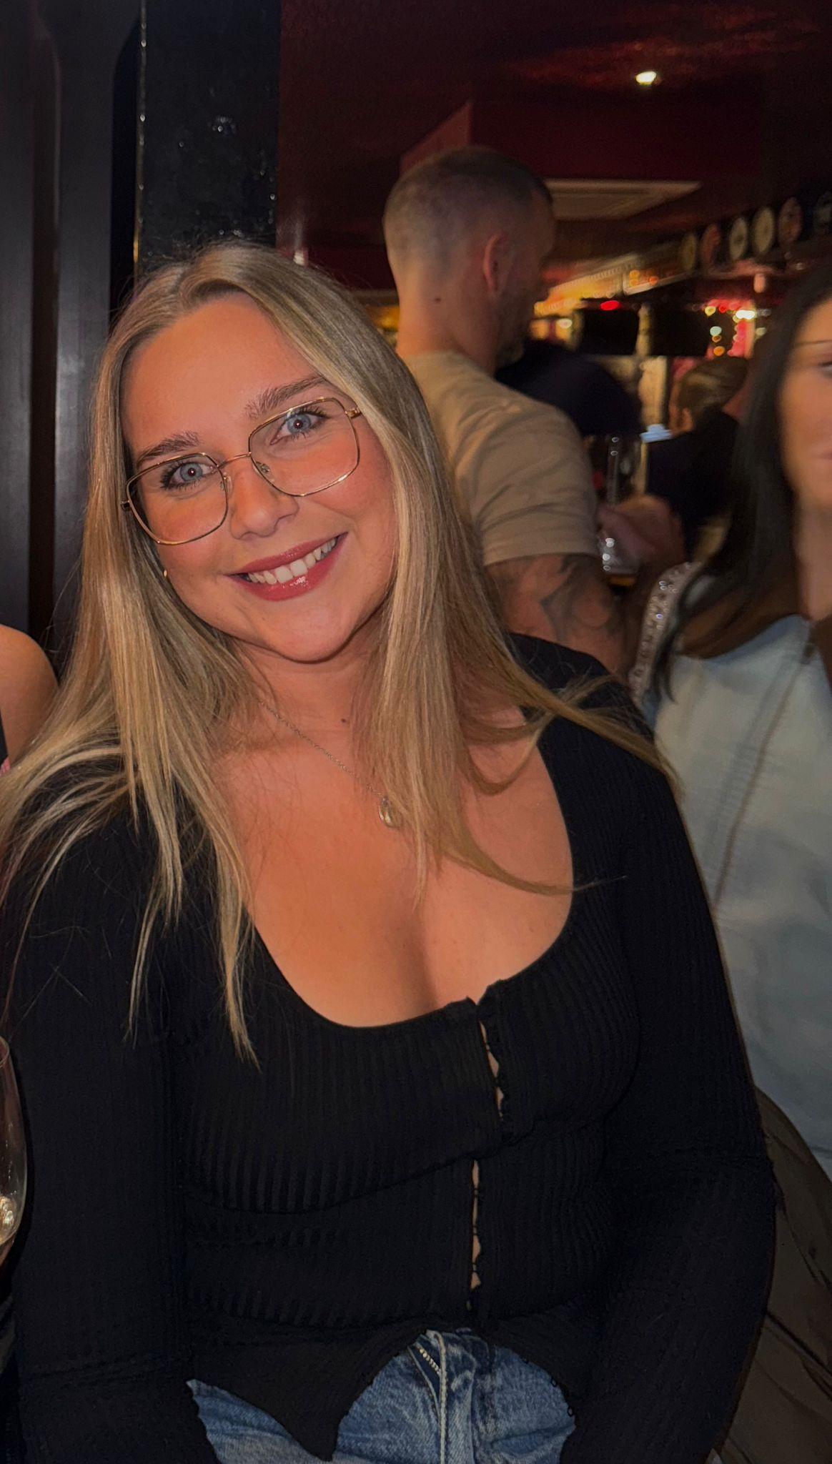
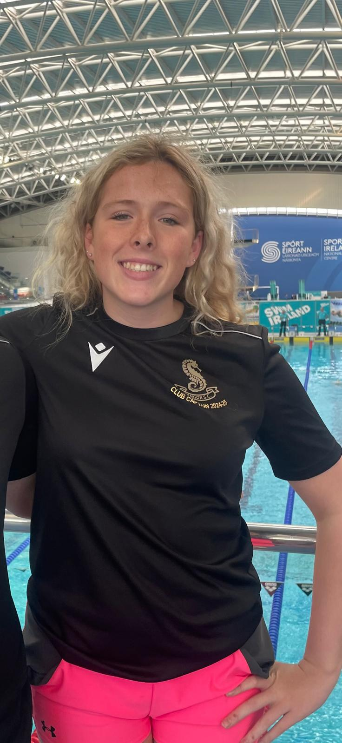
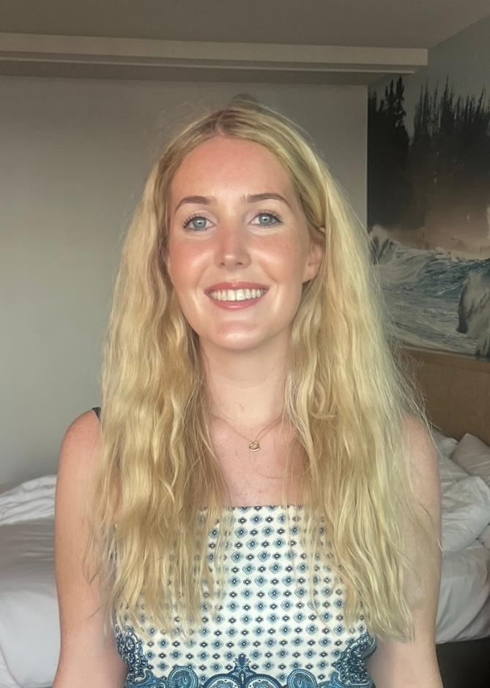
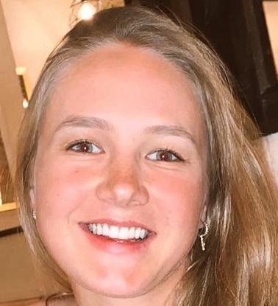
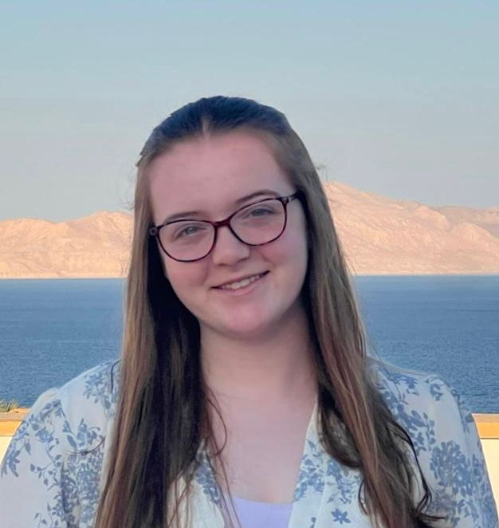
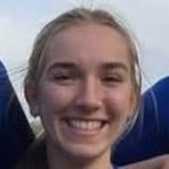
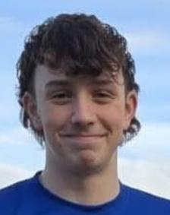
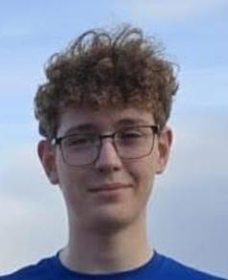
BSC Coaching Team
Mark Stoops
Samuel Wright
Lezah McMullan
Anna Park
Grace McLaughlin
Jasmine Savage
Chris Stewart
Jake Lynas
Austin Williams
Eva McCann
Eve McCutcheon
Naomi Smyth
Claire Gillen
Jemma Speers
Chloe Lyons
Eva Hand
Eddie Kirwan
Matthew Hooker

Slide 7
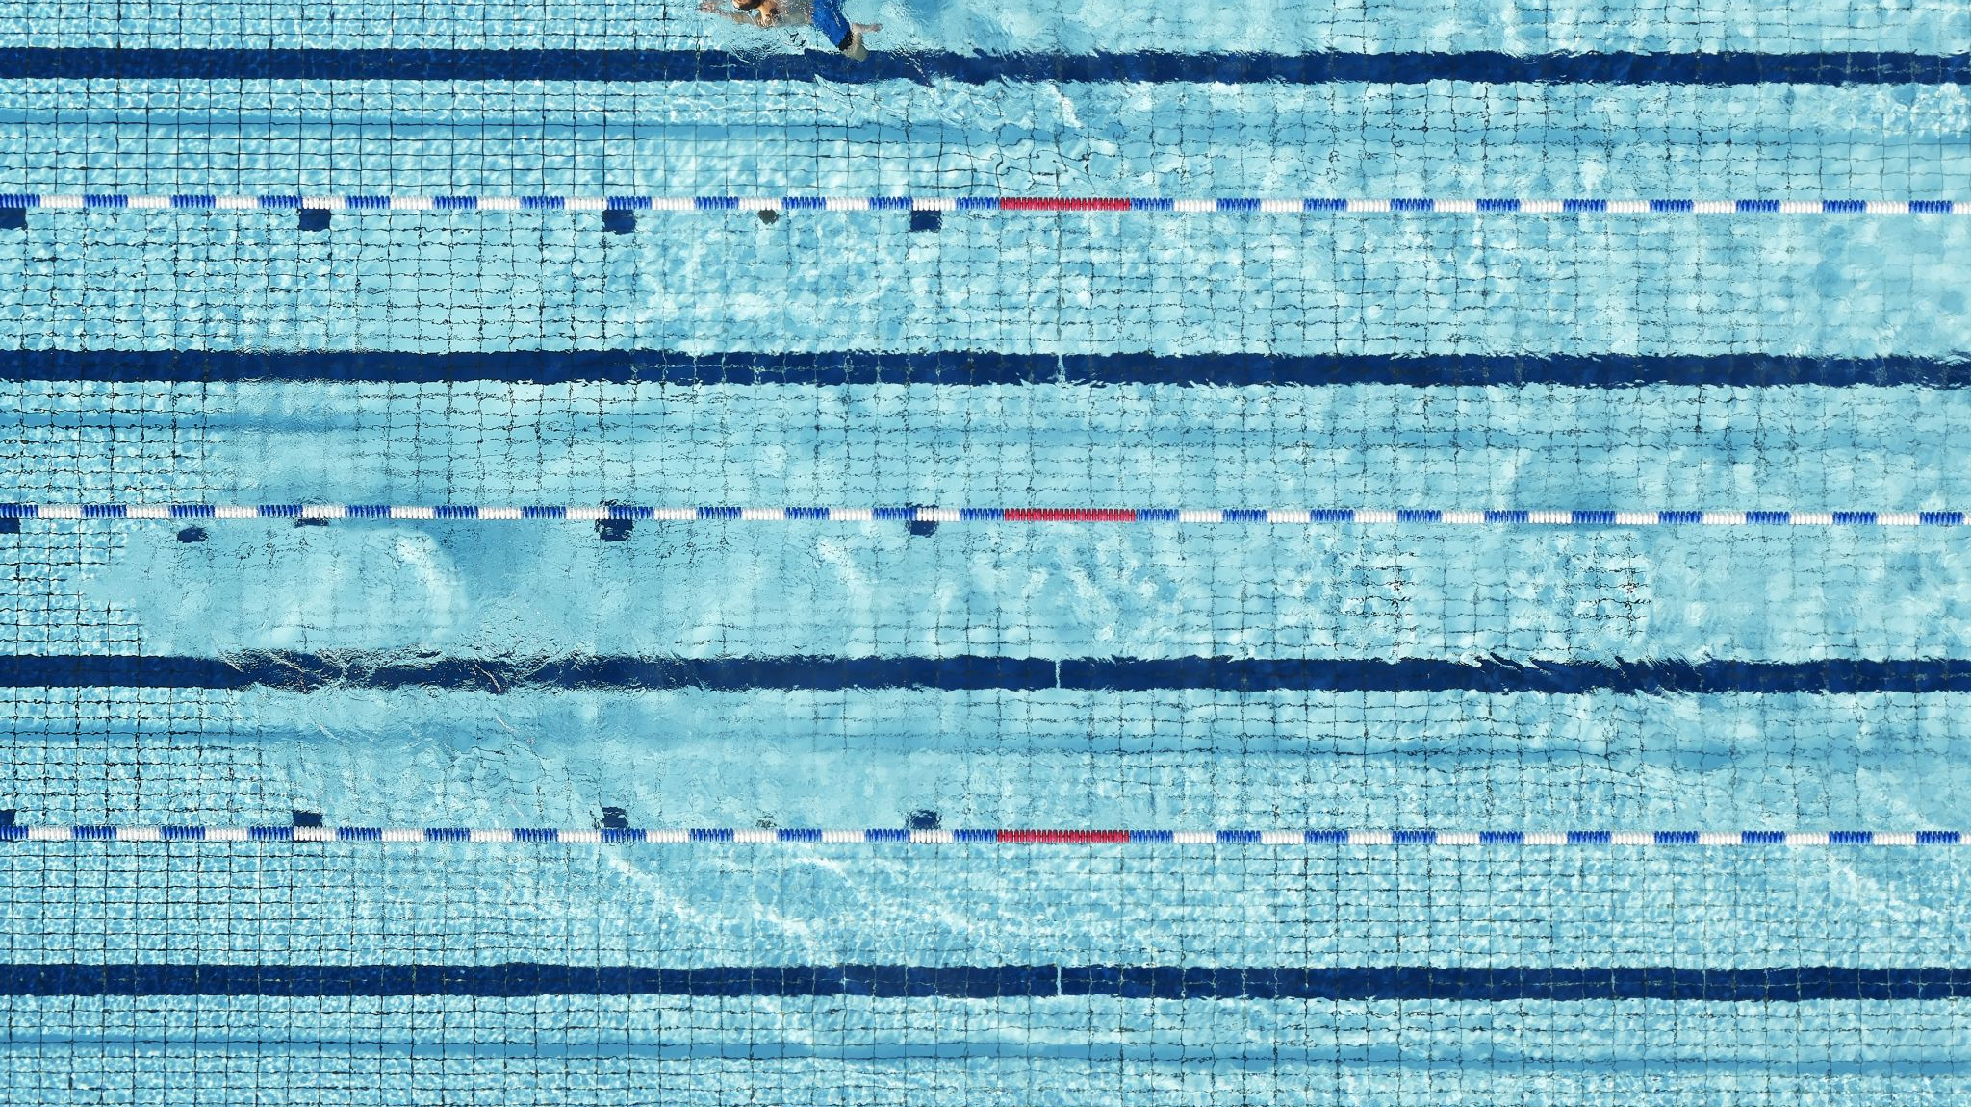
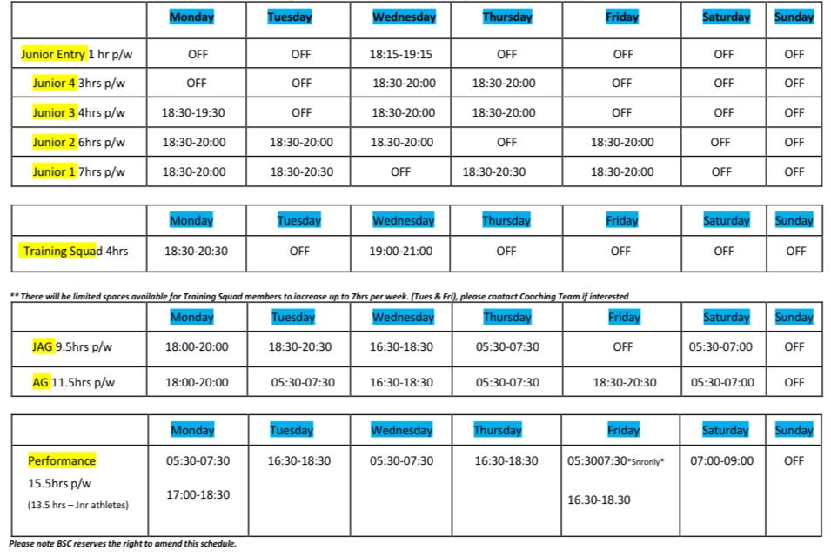
BSC Swim Squad and Timetable 25/26 Swim Season
*hours are subject to change*

Slide 8
Bangor Swimming Club
Athlete Pathway
Squad Level | Club System | Training Phase | Details
1 | Entry | Learning to Swim | The primary objective is to learn the skills involved in swimming by developing each of the four strokes, as well as the core elements of body control, feel for the water, and stable movement patterns. This skill development is particularly important during the early childhood years, beginning at ages 5 to 6 and continuing through ages 9 to 11.
 | Junior 5*
2 | Junior 4
 | Junior 3
3 | Junior 2
 | Junior 1
4 | Junior Age Group | Learning to Train | The second phase that each swimmer enters involves mastering basic skills, with a significant focus on training. This phase aims to maximize potential during the rapid increase in physical capacities that occur during growth and maturation cycles, typically starting at ages 10 or 11 and extending to ages 15 or 16. The primary objective is to progressively extend the volume of training. Training volume becomes a critical factor in long-term improvement. Quality is demonstrated through efficient and effective strokes under increased seasonal loading.
 | Age Group
5 | National Performance | Learning to Achieve | This stage occurs after swimmers master the first two stages, typically in later Age group and early open competition. Success here depends on a strong foundation from phase 2. Swimmers begin event-specific training to develop attributes needed for their races.

Slide 9
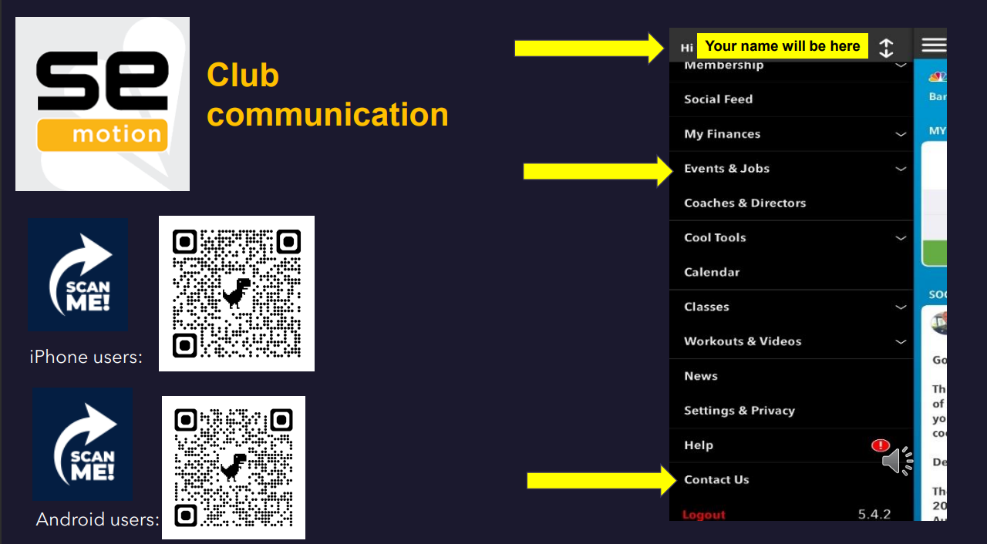

Slide 10
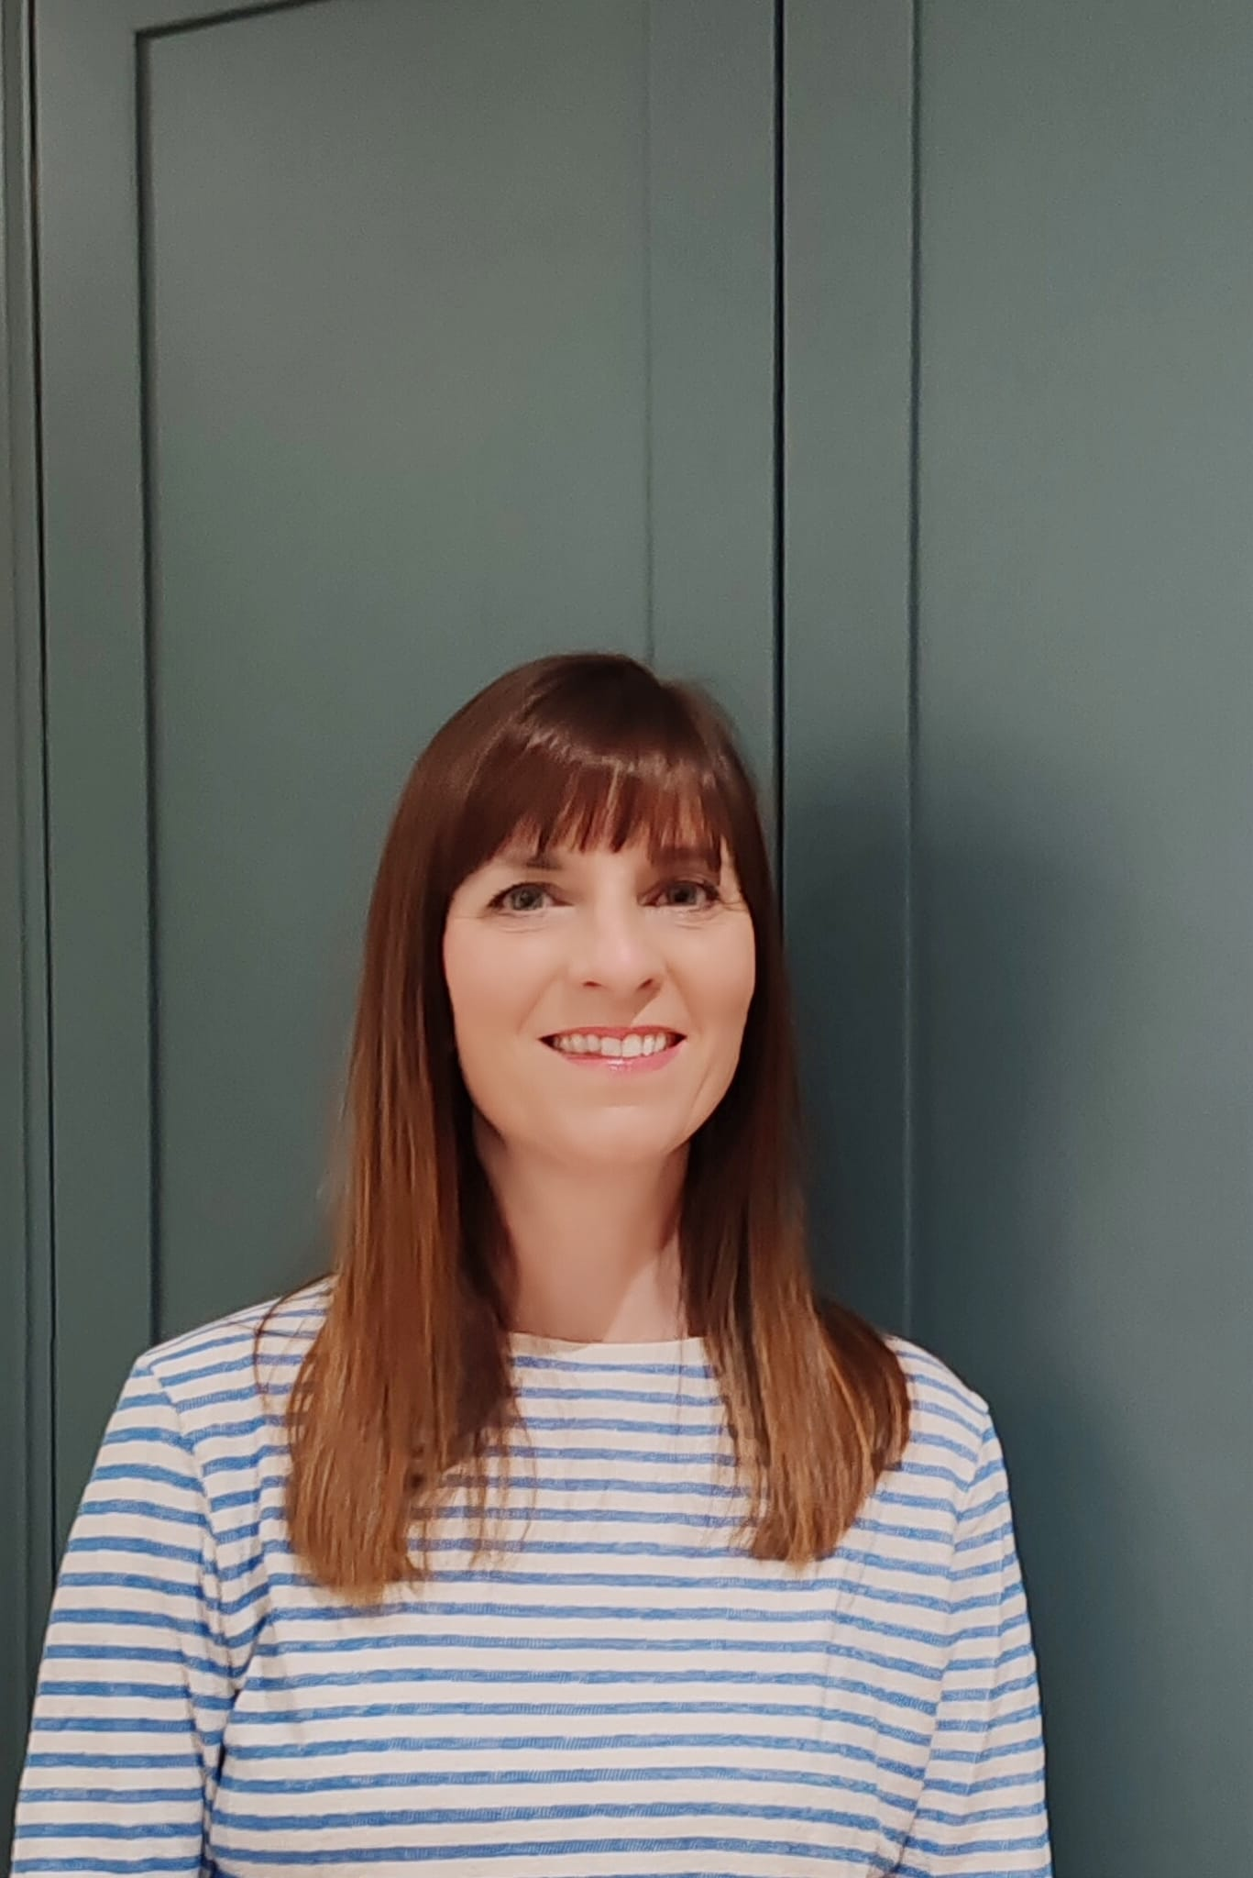
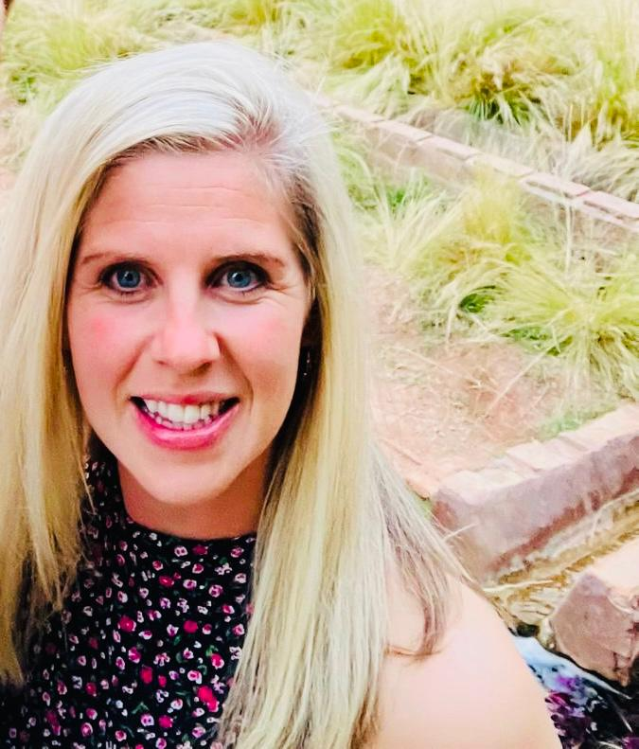
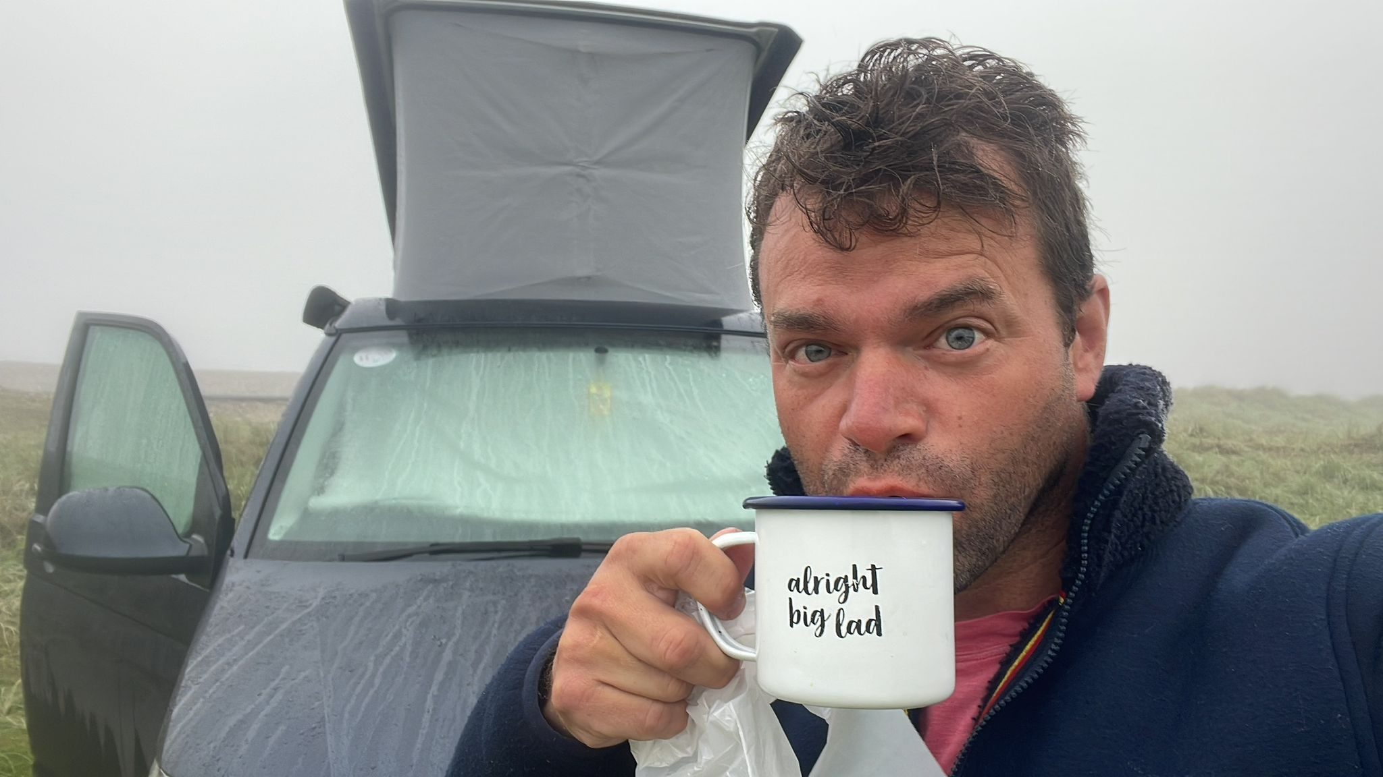
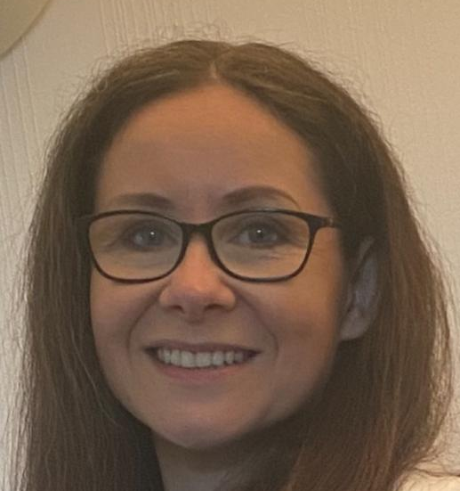
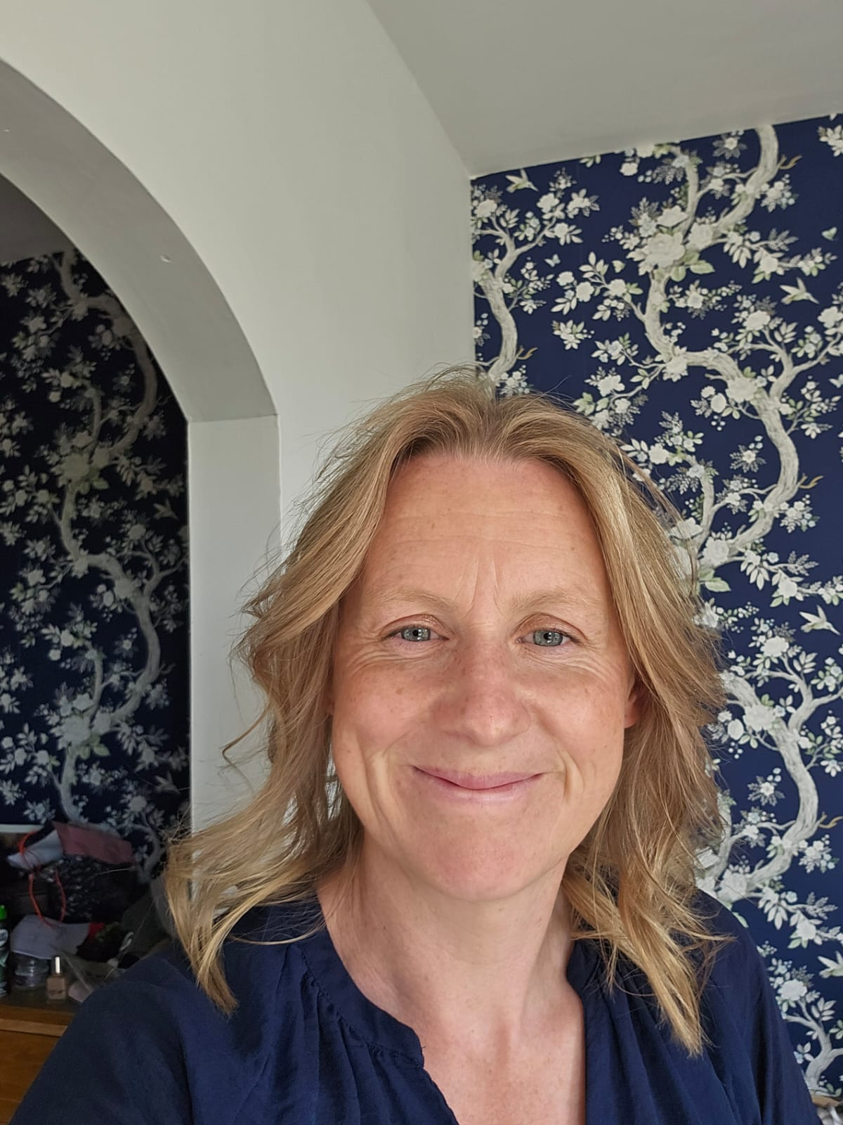
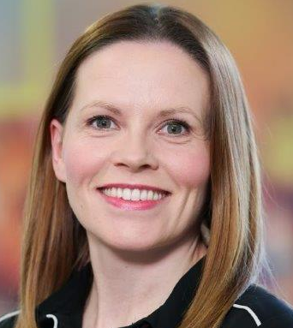


Squad | Name of TM
Junior Entry (JE) | Jennifer Gill
Junior 4 (J4) | Iain McCarthy
Junior 3 (J3) | Katie Legg
Junior 2 (J2) | Jennifer Gill
Junior 1 (J1) | Ildiko Hamilton
Junior Age Group (JAG) | Jenny Moore
Age Group | Esther Coulter
Training Squad | Caroline Kirwan
Performance | Carol Boal
BSC Team Managers (TM)

Slide 11
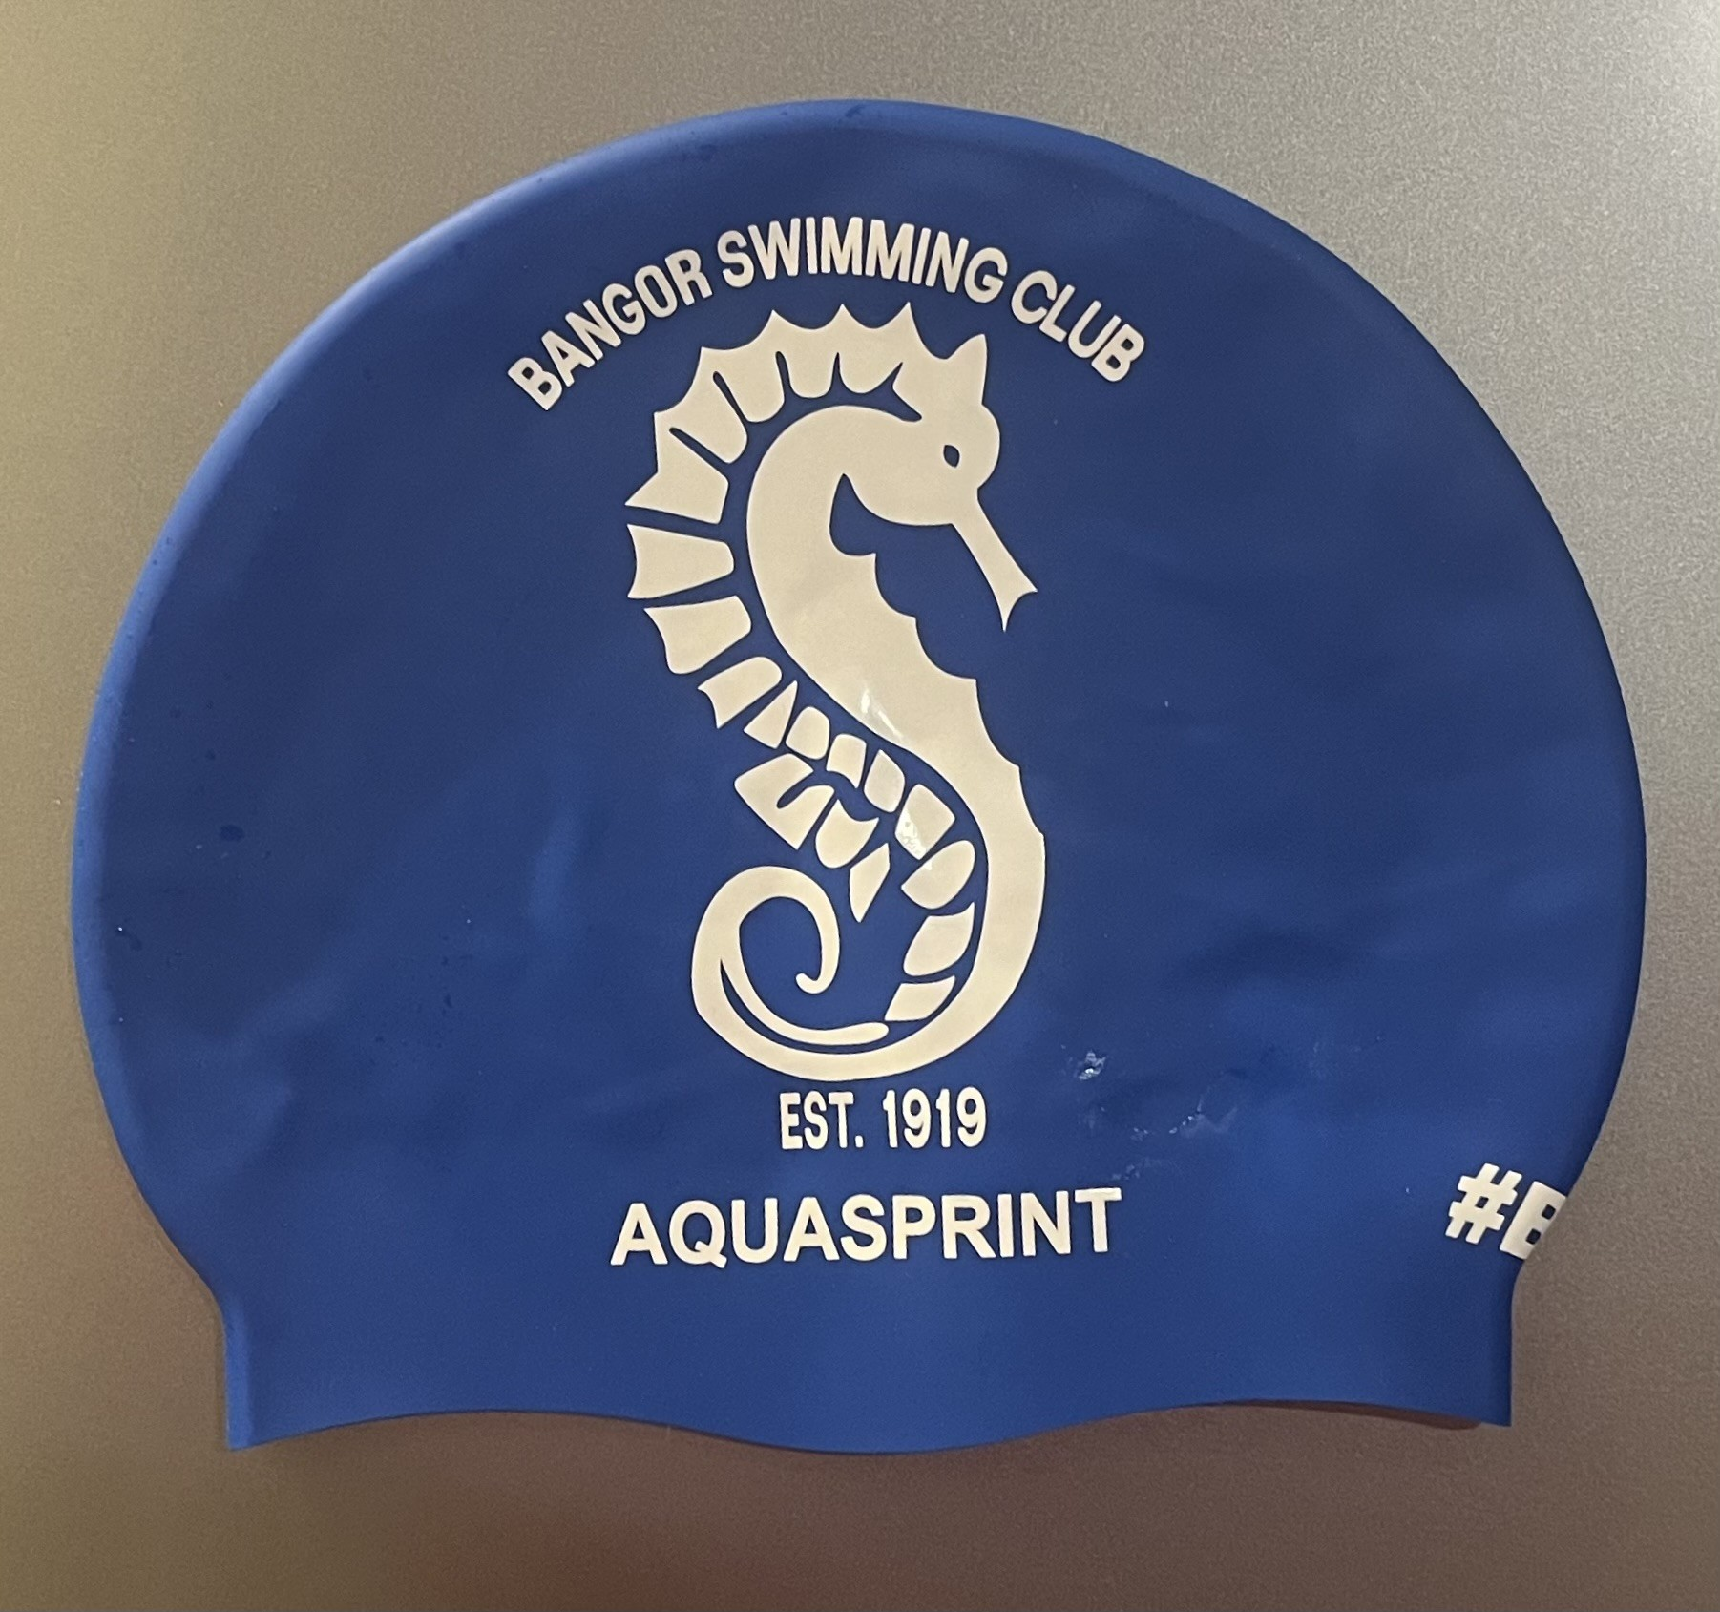
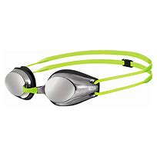
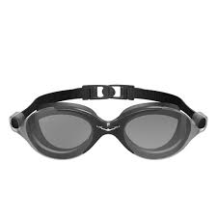
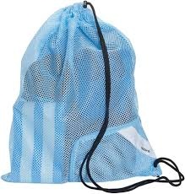
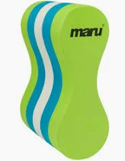
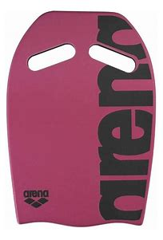


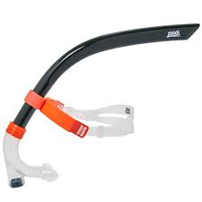
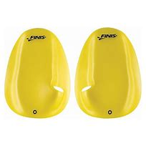
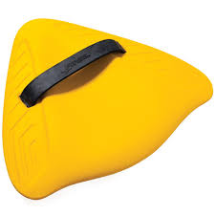
Swim Equipment
Mesh Bag ( the swimmer brings their equipment on poolside with them)
X 2 pair of swim googles (one spare for the kit bag)
BSC Hat
Swim Snorkel
(J3 upwards)
Paddles J1 upwards
Pull Buoy
(From J5)
Alignment Board (from JE squads) or Kick Board (J1 upwards)
Short Fins (JE upwards)or
Power Fins (J1 upwards)

Slide 12

Useful links as you begin or continue your journey with BSC:
https://swimireland.ie/wp-content/uploads/sites/2/2024/02/Person-on-duty-February-2024.docx
https://www.swimulster.com/wp-content/uploads/2025/09/Draft-Competition-Calendar-2025-2026-v388.xlsx-Read-Only.pdf

Slide 13


